Slide 1
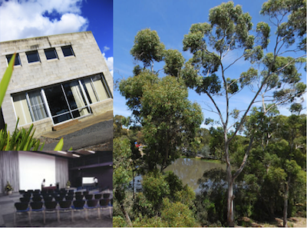
29th Australian Colloid and Surface Science Student Conference Ballarat, Victoria, Australia Feb 3-7, 2014
The Australasian Colloid and Interface Society (ACIS) Presents:
The ACSSSC provides postgraduate students of colloid and surface science with an opportunity to present and discuss their research in an informal, supportive and friendly atmosphere. The Particulate Fluids Processing Centre at the University of Melbourne has the honor of hosting the:
Venue: University of Ballarat, Mt. Helen Campus, Ballarat, Victoria, Australia
Website: http://colloid-oz.org.au/acsssc/
Abstract Submission Closes Nov. 29th 2013
Contact: A/Prof. Raymond Dagastine & Dr. Anthony Stickland – Conference Chairs
Email: rrd@unimelb.edu.au or stad@unimelb.edu.au
29th ACSSSC from February 3-7, 2014

